Slide 1
End-to-End: Automotive eCommerce Platform
Java Competency
NashTech

Slide 2
Overview
Problem statement
Architecture overview
Microservices and domains
Microservices
CI/CD
Infrastructure provisioning(env)
Data platform on Databricks
Data ingestion pipeline
Data governance with databricks unity catalogue
Integration of databricks with Microsoft PowerBI for visualization and reporting

Slide 3
Problem Statement

Slide 4

Problem Statement
XYZ automobile Inc is automotive company wants build an eCommerce platform for selling the cars.
User can do product searching, placing an order through cart, make a payment etc.
There should be an inventory management.
A secure centralized data platform for data analytics and AI/ML use case implementation
Solution
By understanding the business problem, developed the whole platform by following Domain Drive Design principle.
Developed microservices with Axon Framework. Each microservice solve a business problem or representing a domain for example order, product, cart, inventory etc.
The data platform is built on Databricks, a unified platform for data engineering, data governance, data analytics, and AI/ML.
Established a secure integration of Microsoft powerBI with databricks for visualization and reporting.

Slide 5
Architecture Overview

Slide 6
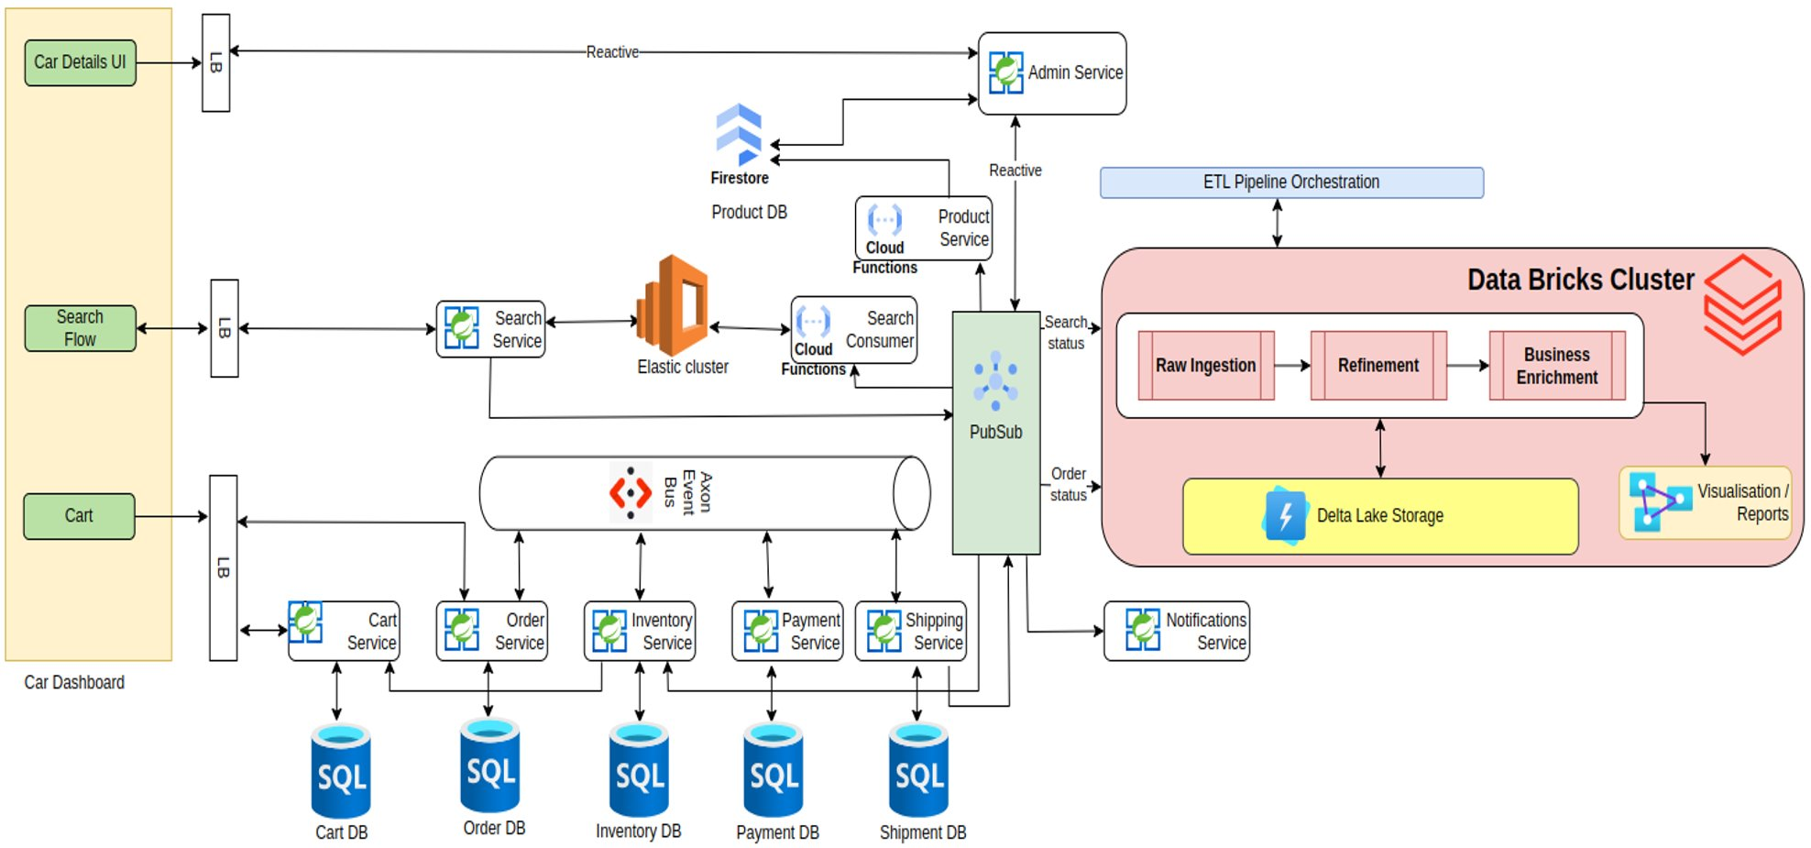
High level architecture

Slide 7
Microservices and domains

Slide 8
Microservices and Domain products
Shipping - streamline outgoing shipments to customers with pricing on shipments and confirmation notifications
Order - receives a customer order, order details including items, item quantities
Payment - Involves the user verification, and settlement of transactions
Inventory - Manage car [product] that are available for sale
Admin - It interact with the cloud (GCP) to push data into a Pub-Sub system and fetch the refine data from the cloud-managed reactive MongoDB repositories.
Cart - Allowing customers to select items from the store's website
Car Dashboard - The customer browses the store's website and selects the products they want to purchase
Product Service - The cloud function that performs data transformations like currency conversion, mileage conversion and securely stores the processed data into Firestore, a scalable NoSQL document database provided by Google Cloud Platform.

Slide 9
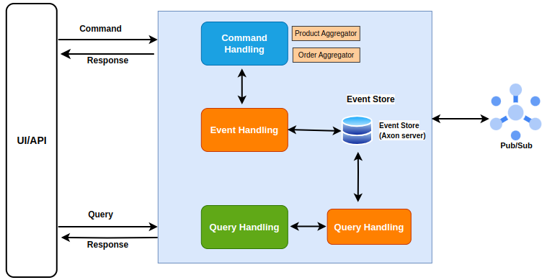
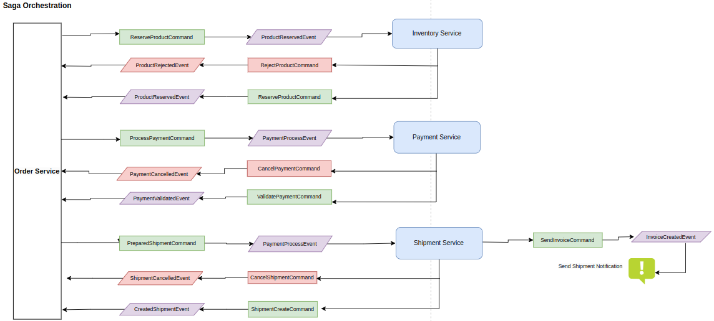
AxonIQ CQRS

Slide 10
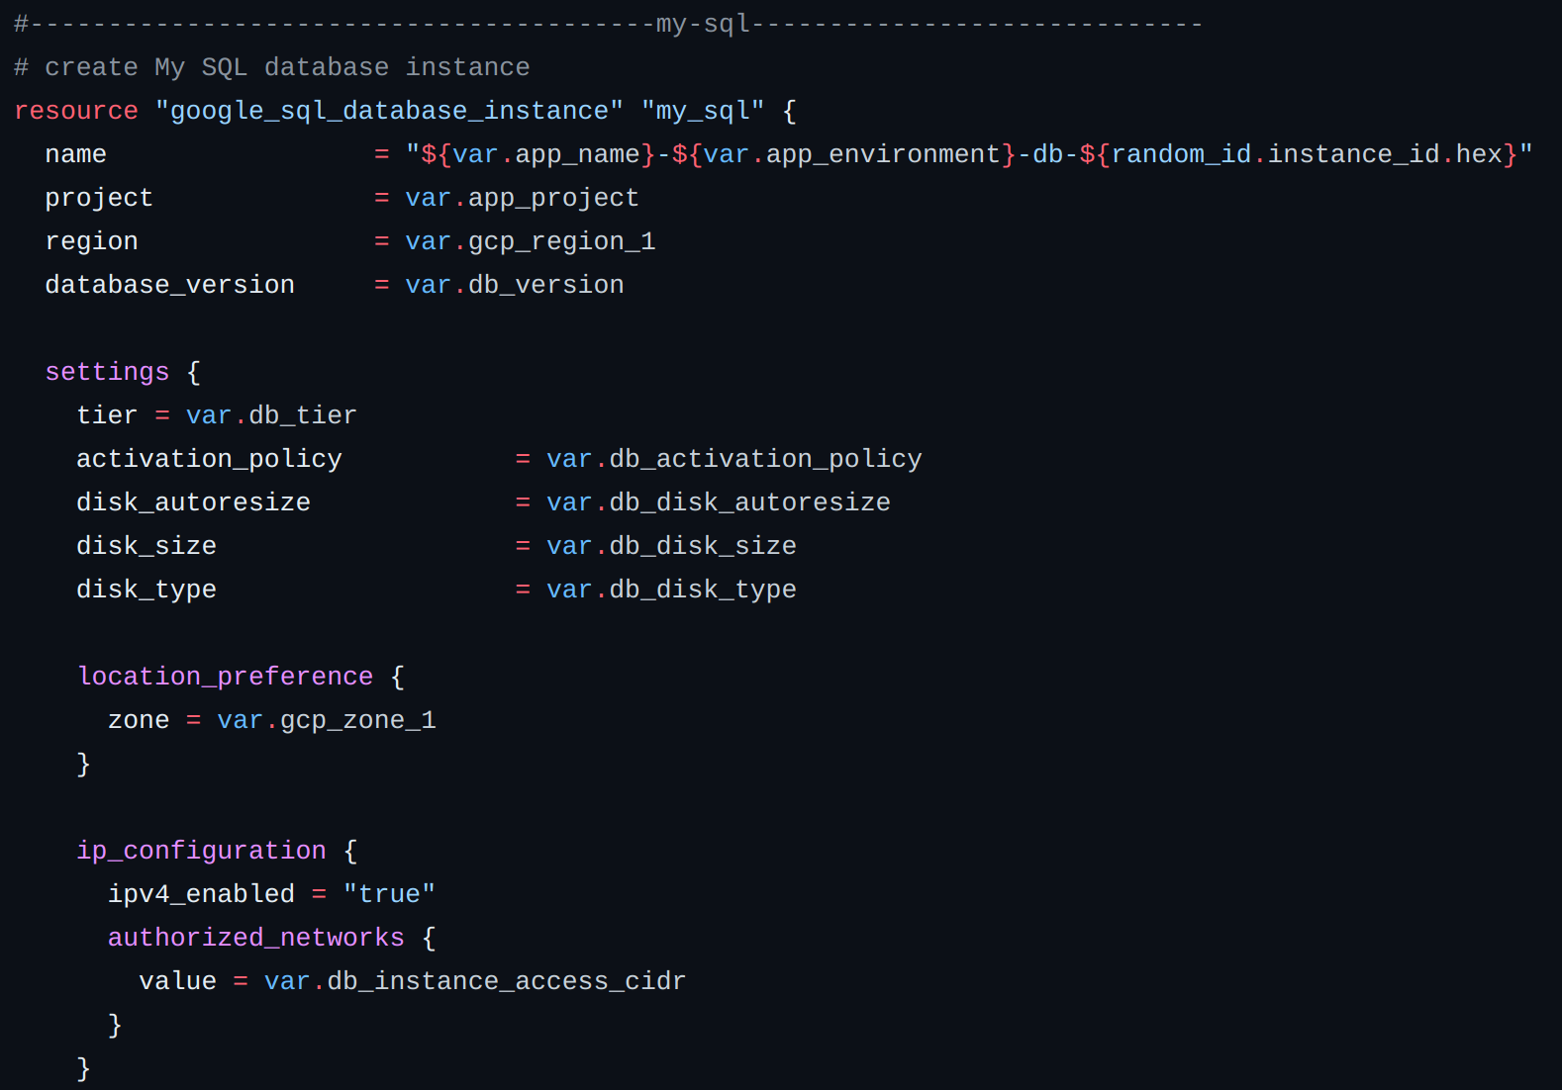
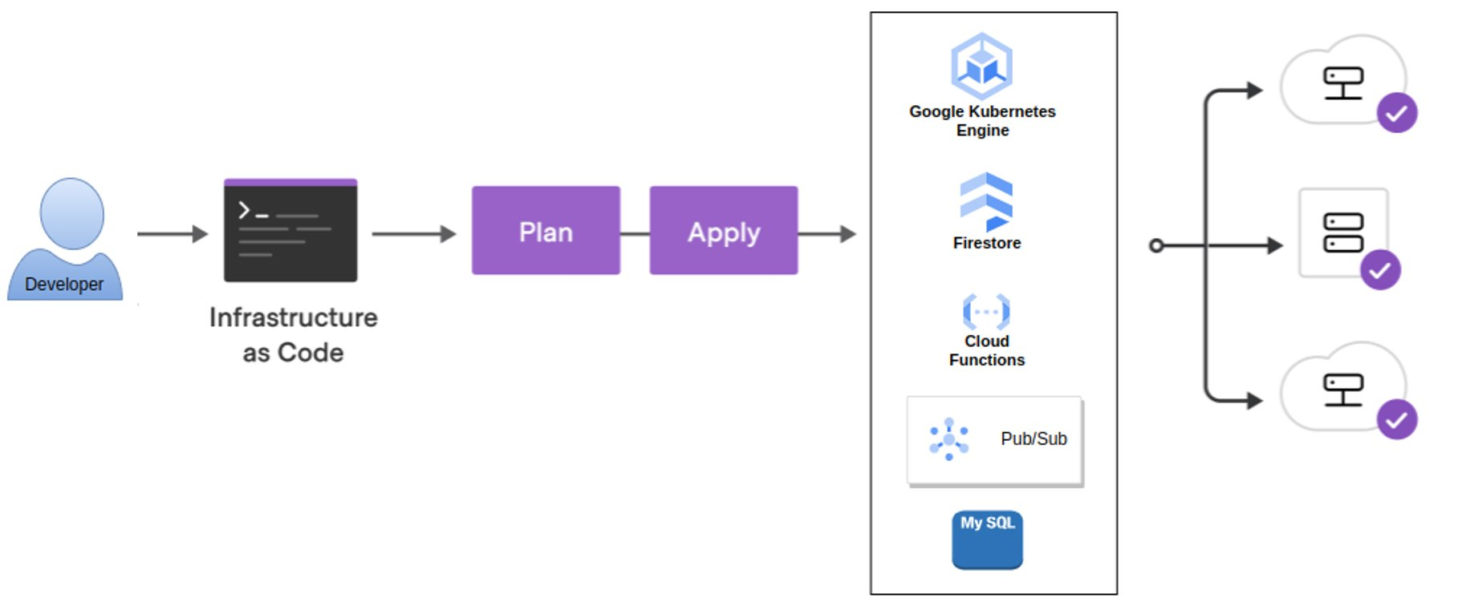
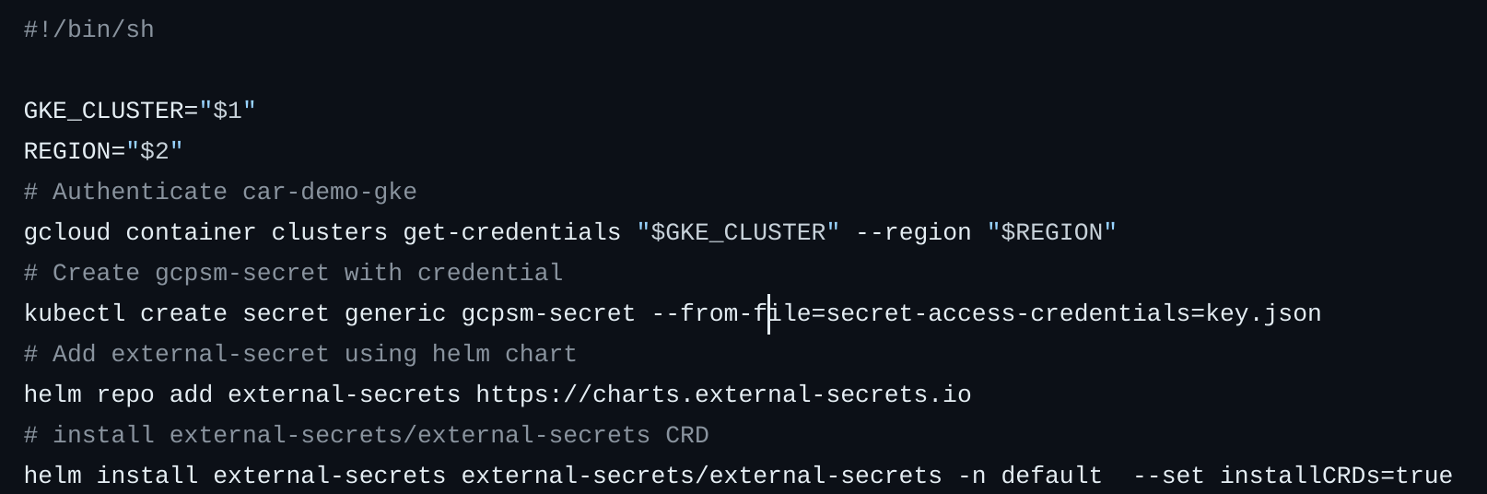
Infrastructure Provisioning

Slide 11
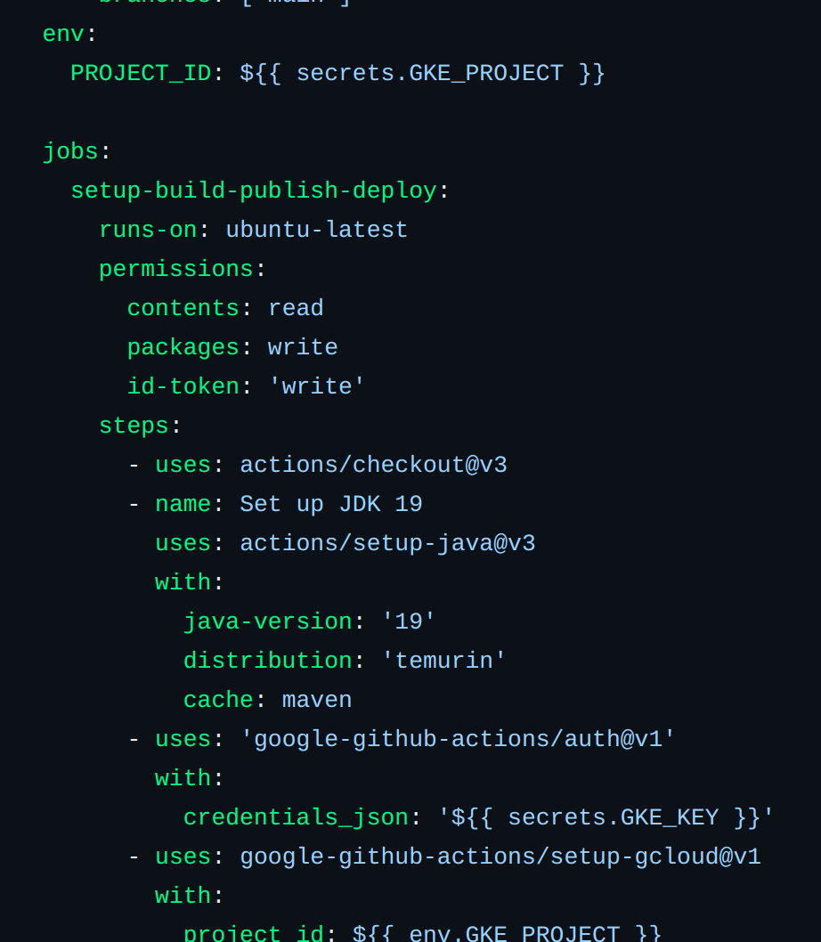
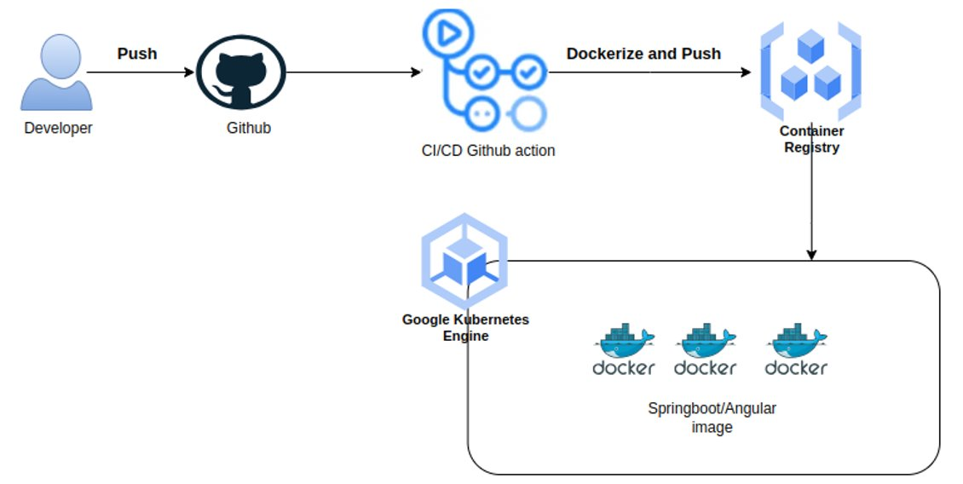
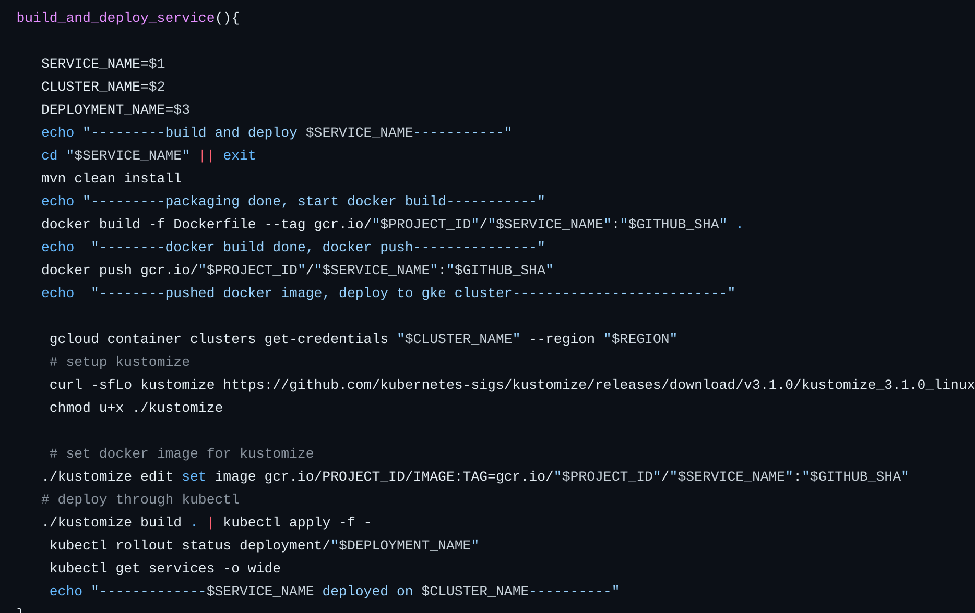
CI/CD

Slide 12
Data platform Solution(Lakehouse)

Slide 13
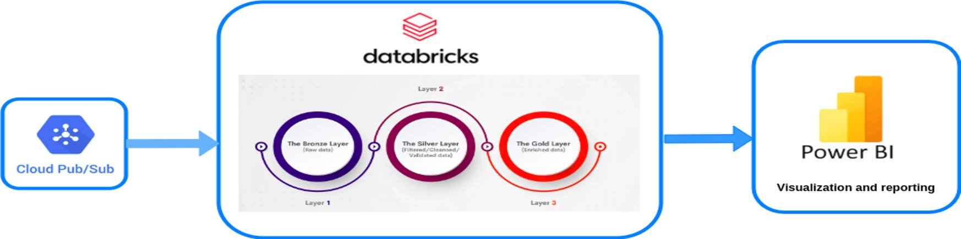
Data Pipeline
Developed an integrated centralized data analytics platform that allows the customers to conduct data analysis in a consistent and integrated environment.
Developed and Deployed streaming Data pipeline on databricks. Pipeline consumes the data from gcp pubsub topic and persist to databricks delta lake table.

Slide 14
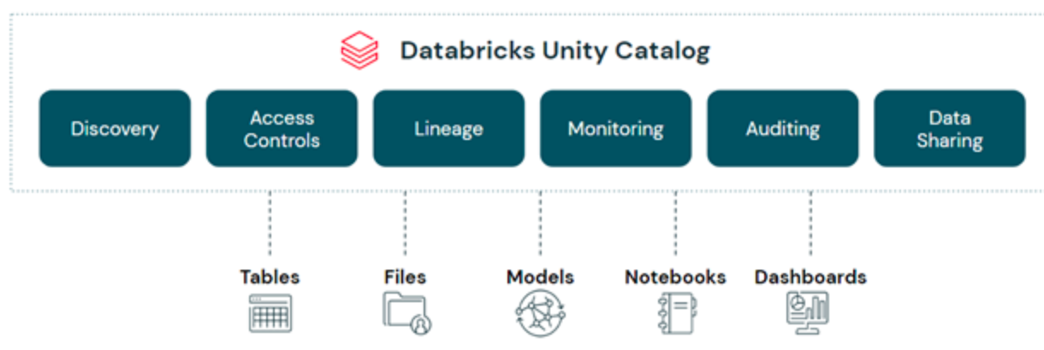
Data Governance: Unity Catalogue
Databricks unity catalogue is a unified governance solution for data and AI on the lakehouse. With Unity Catalog, organizations can seamlessly govern their structured and unstructured data, machine learning models, notebooks, dashboards and files on any cloud or platform.

Slide 15
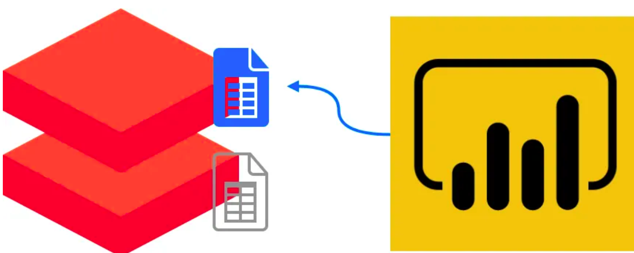
Databricks integration with powerBI
Secure Integration of Databricks object(Table view) with Microsoft powerBI.
Using Databricks service principle.
Granular permission grant to service principle to access databricks resource

Slide 16
DEMO

